Slide 1
Subtle Context Feature Extractor
Document style analysis
by Cezary Troska and Antoni Dąbrowski

Slide 2
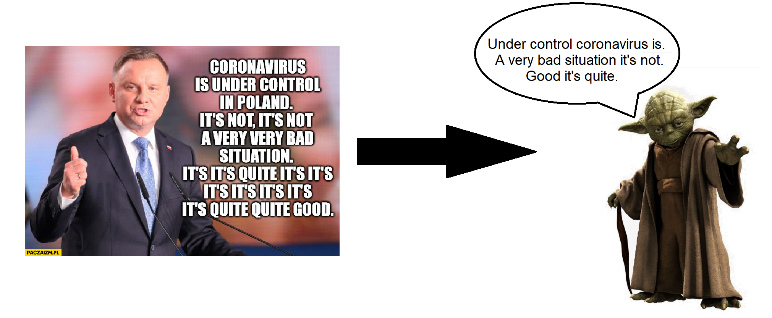
Problem introduction - style transfer

Slide 3
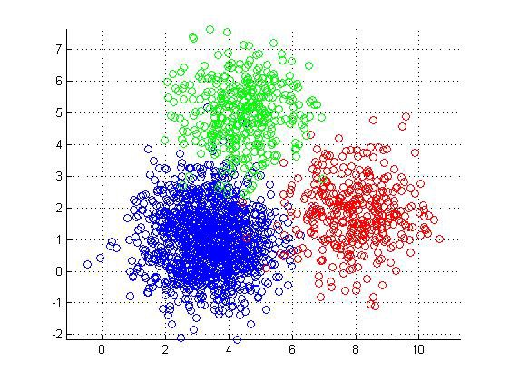
Problem introduction
unsupervised style analysis
Notes:
sentiment clustering

Slide 4
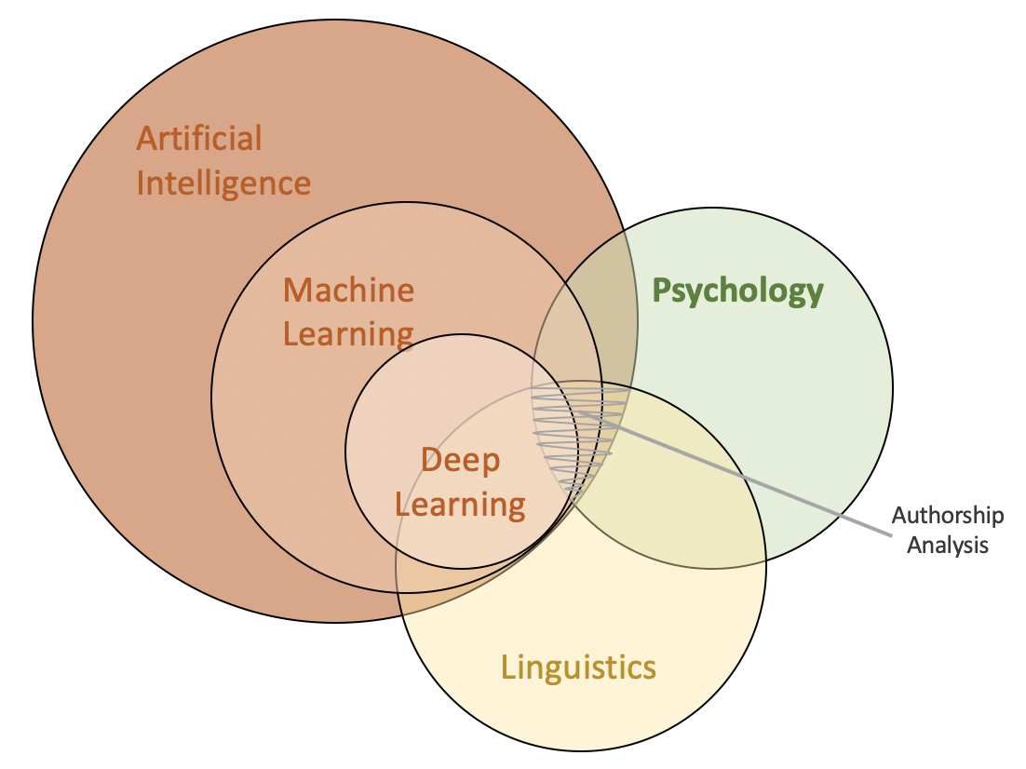
Problem introduction

Slide 5
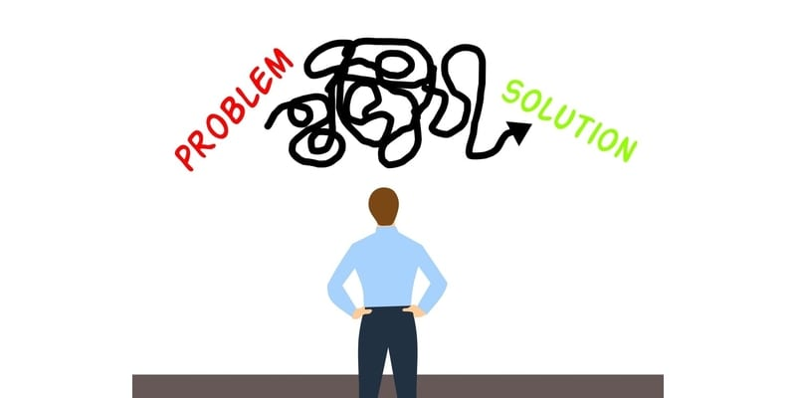
Problem introduction
Notes:
Three introduced problems have one in common. We can solve them with a ‘text2vector_style’ model.

Slide 6
How to get a style from the text?
What is style?
style + content = text → style = text - content
How to get texts different in terms of style and similar in terms of content?
translations…?
What are pros/cons of analysing translations?
the best what we can get ‘out of the box’
– it isn’t pure translator style, it’s rather author style biased by translator language model (?)

Slide 7
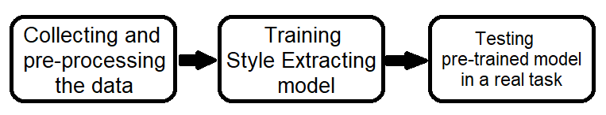
Project plan

Slide 8
Collected data
‘Holy Bible’ - 45 translations
‘Quran’ - 51 translations
‘Madame Bovary’ - 4 translations
‘Les Miserables’ - 4 translations
‘The Count of Monte Cristo - 4 translations
‘Madame Bovary’ - 4 translations

Slide 9
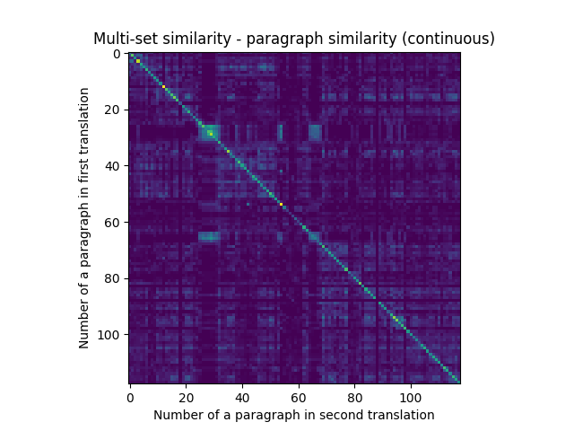
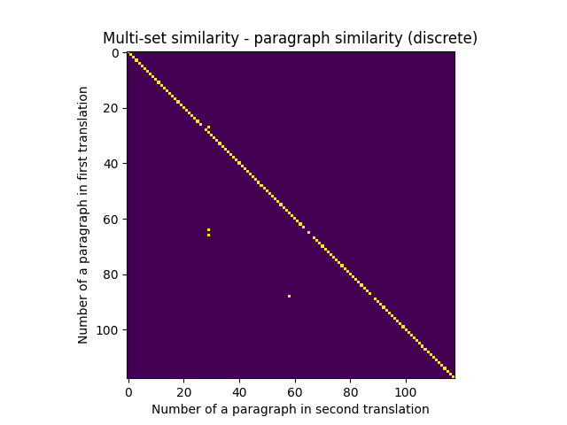
Data pre-processing
Translations matching

Slide 10
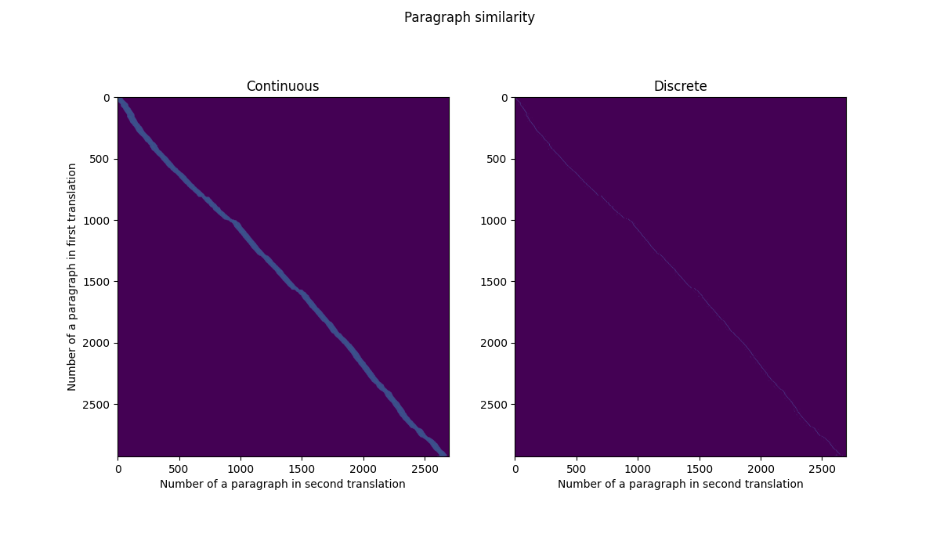
Data pre-processing
Successful match

Slide 11
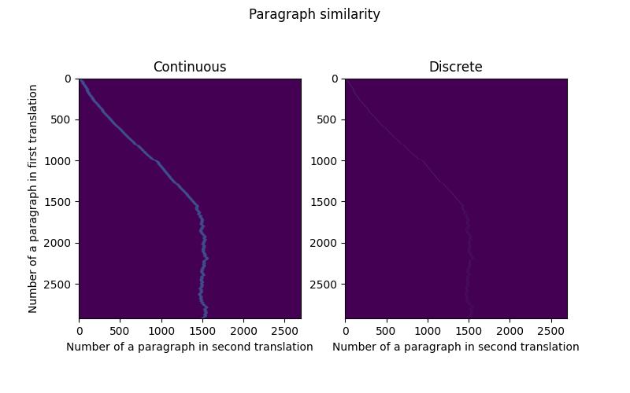
Data pre-processing
False match

Slide 12
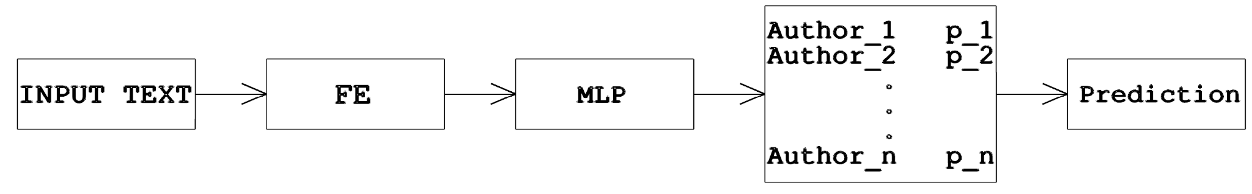
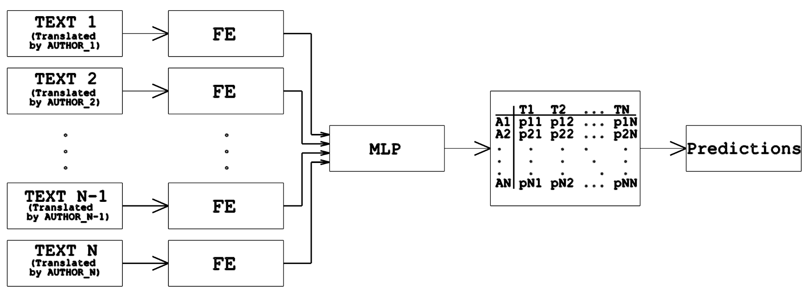
Models

Slide 13
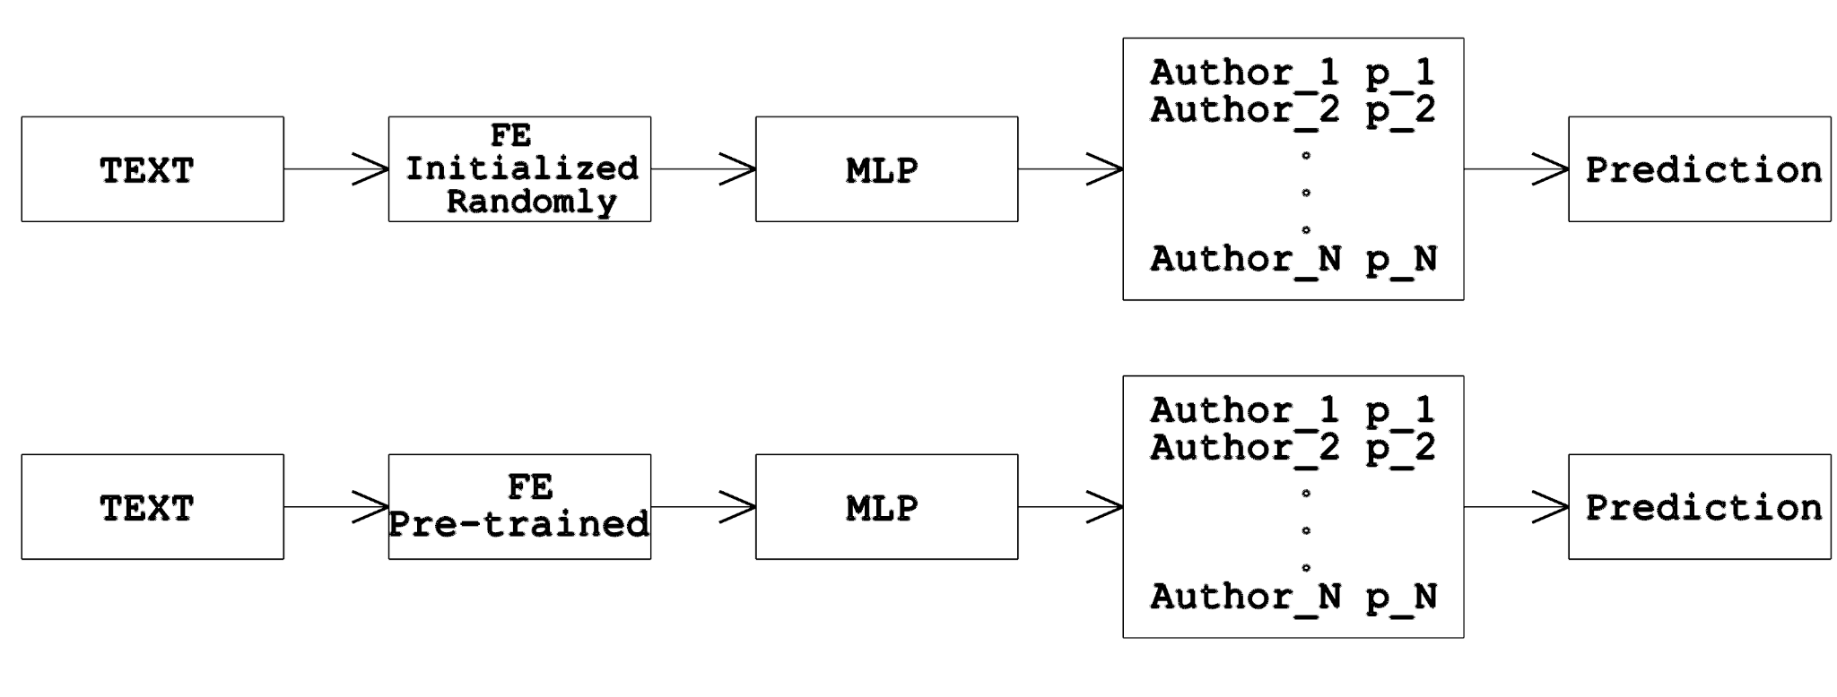
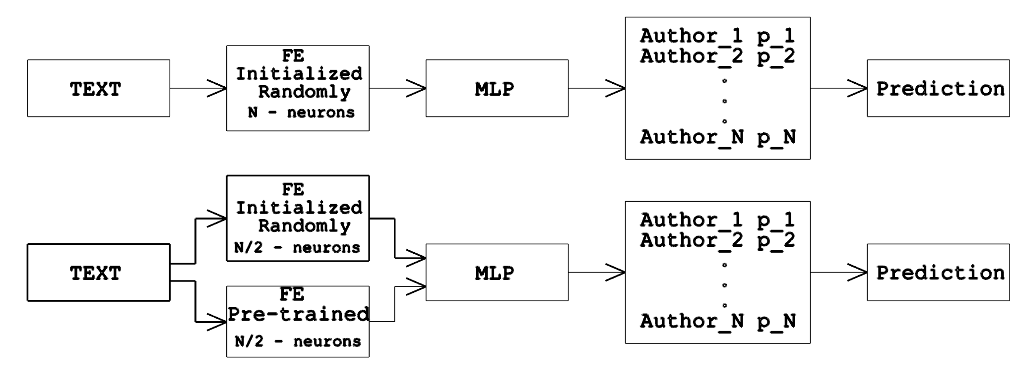
Hypotheses

Slide 14
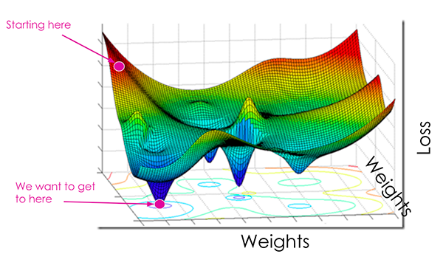
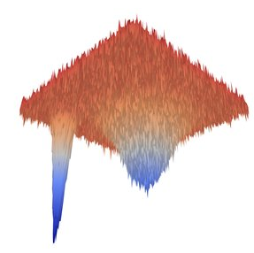
Motivation

Slide 15
Testing process

Slide 16
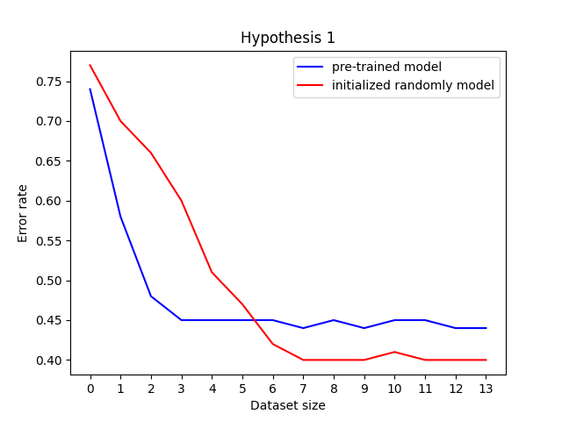
Results & conclusions

Slide 17
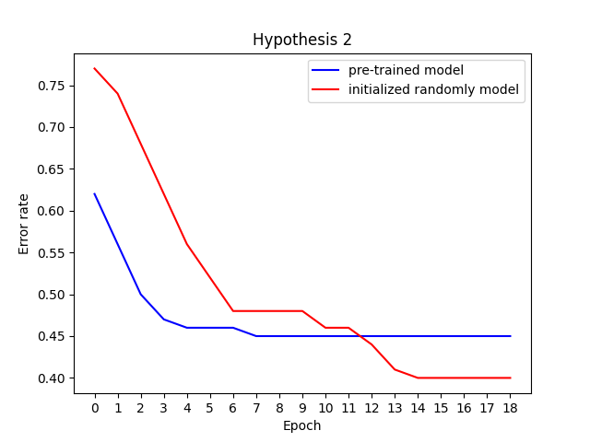
Results & conclusions

Slide 18
Future work
change LSTM to some more sophisticated model
use FE in some other tasks e.g. text style clusterization, text style transfer
think a better way to get the date (not translations)

